Slide 1

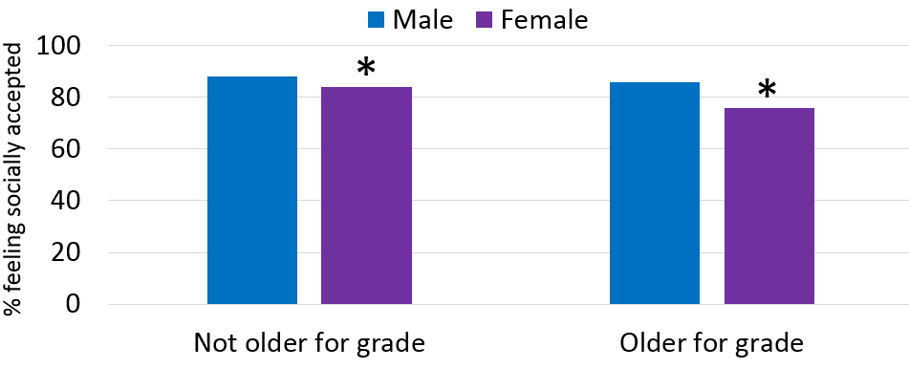
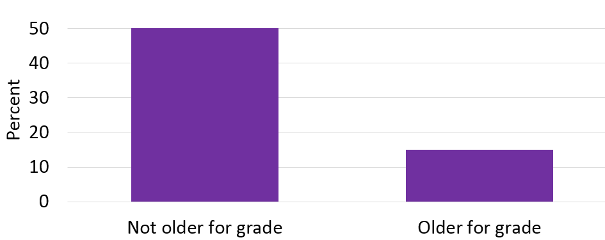
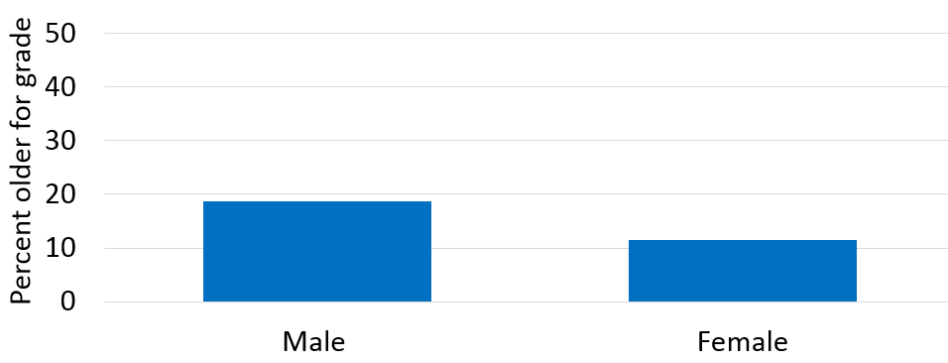
The Association between Gender and Academic “Redshirting” among
Middle and High School Students in the United States
Lisa Dierker, Wesleyan University
Introduction
Results
Results continued
When my oldest son started kindergarten, days after his 5th birthday, I noticed that many of the boys in his class were turning 6 years old early in the school year and that several were already 6 when school started.
I soon learned about a local and national trend know as "redshirting”, a term coined for college football players who maintain an extra year of sports eligibility by not playing as freshmen.
I wondered if parents are more likely to “redshirt” boys than girls and also whether being older relative to one’s grade might provide an advantage with the result being adolescents who feel more socially accepted.
Univariate
The sample was 51.6% female and 48.4% male
711 (15.0% ) of the sample with valid age and grade information were older for their grade.
The Association between Being Older for One’s Grade and Feeling Socially Accepted by Gender
Percent of Middle and High School Students Who are or are not Older for Their Grade
Research Question
Is gender associated with being older relative to one’s grade during middle school and high school?
Are students who are older relative to their grade more likely to feel socially accepted and is this true for both males and females?
Discussion
Bivariate
Males (18.7%) were more likely to be older for their grade than females (11.5%)
As expected, males were more likely to be “redshirted” (i.e. older for their grade), than females.
However, being older for one’s grade was not associated with being more likely to feel socially accepted, Instead, there was no association for males, and the association was in the opposite direction for females, with females older for their grade being less like to feel socially accepted than females who were not older for their grade.
Notably, the preset findings did not take into account being held back in school after kindergarten which may have influenced the results, In other words, “redshirting” might not always occur in kindergarten and may be driven by factors other than wanting to provide a social or academic advantage.
Methods
Sample
6504 adolescents in grades 7 through 12 who participated in the first wave of the National Study of Adolescent Health (Add Health) and who were included in the public access sample.
Measures
Interviewers recorded each adolescent’s biological gender.
Adolescents who were a year or more older than the typical age range for each grade level were classified as being “older for their grade” (e.g. >14 in grade 7, >15 in grade 8, etc.). Adolescents within the typical range for each grade level or younger were classified as “not older for their grade”.
Those who agreed or strongly agreed that they “feel socially accepted” were classified as feeling socially accepted. Those who responded neither agree or disagree, disagree, or strongly disagree were classified as not feeling socially accepted.
The Association between Gender and being Older for One’s Grade
Overall, females were slightly less likely to feel socially accepted (83.5%) than males (87.4%)
When examining the association between being older for one’s grade and feeling socially accepted, by gender, males who were or where not older for their grade were equally likely to feel socially accepted, while females who were older for their grade were less likely to feel socially accepted than females who were not older for their grade.
Future Directions
With a larger sample who were older for their grade, I would have liked to explore whether these finding would be similar for adolescents from different race or ethnic groups.
Notes:
1

